Slide 1
Dashboard Design Project
Tool Used: Power BI
Dataset: Financial Sample Dataset
Objective:
Design an interactive dashboard for business stakeholders.

Slide 2
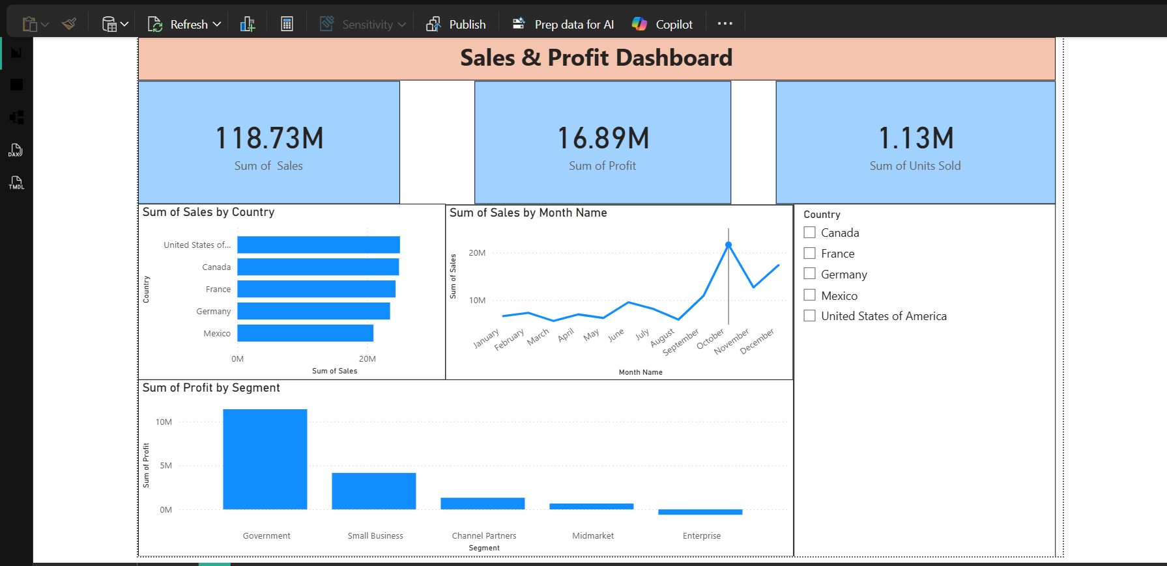
Sales and Profit Dashboard
• Total Sales: 118.73M
• Total Profit: 16.89M
• Government segment generated the highest profit.

Slide 3
Conclusion
• Dashboard provides sales and profit analysis.
• Country slicer enables interactive filtering.
• Monthly trend chart helps identify sales patterns.
• Dashboard supports data-driven business decisions.

